Slide 1
Introduction to
IoT and AI
Where are we headed??
Rika Yoshii, Ph.D. Computer Science, California State University, San Marcos.

Slide 2
Me?
Artificial Intelligence(AI)
Machine Translation of languages
Tutoring Systems for Language Learning
But I rarely call a system “Intelligent.”

Slide 3
AI?
Narrow sub-area performer vs. general intelligence.
Machines are now good at specific tasks such as
image recognition, diagnosis, playing chess, spam detection, information retrieval, data analysis.
Machines are not yet good at general natural
language understanding and other general cognitive tasks.
What’s hard for a human is often what’s easy for a computer.
What’s easy for a human is often what’s hard for a computer.

Slide 4
The 3rd Industrial Revolution
History:
Darpanet
Internet
Smartphones
But now the 4th Industrial Revolution!! thanks to Cloud Computing and IoT.

Slide 5
Simple IoT
House-hold item (or any device)
Internet
User
Control devices from far away

Slide 6
Simple IoT
Device
with sensors
Internet
Stores
Order items automatically
Also, allows us to collect data!!!!!!

Slide 7

Hey, let’s embed a lot of sensors in everything!
In coffee machines
What else???
In microwaves
In fridges
In washers
In beds
In cars
In dog collars
In chopsticks
In belts

Slide 8
How Many Devices are Connected?
2020 – 9.76
2023 – 15.14
2030 – 29.42 billion
www.statista.com

Slide 9
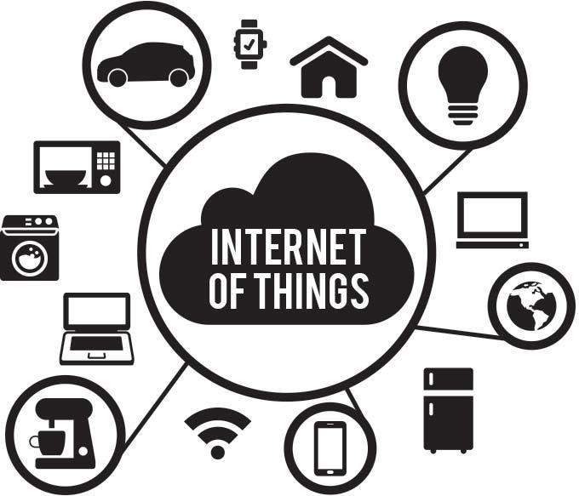
Lots and Lots of Data is Collected

Slide 10
Big Data? Massive in terms of size and types
petabyets – exabytes – 64.2 zetabytes in 2020
Databases
Data from sensors
Web Pages
Social Media

Slide 11
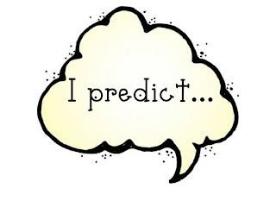
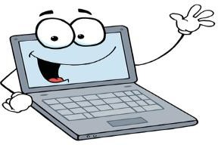
Why Analyze Big Data?
Find unexpected correlations among things (new insights):
To help identify things
To help classify things
To help predict
Want to know:
What’s related to a cancer?
Where and at what time will a burglary happen in the city tonight? Who will get married before age 35?
Where will we have a big earthquake next year?
When do pedestrians move this way? Other cars move this way? What products to develop?
What is the person thinking of? (neuro-semantics with fMRI)

Slide 12
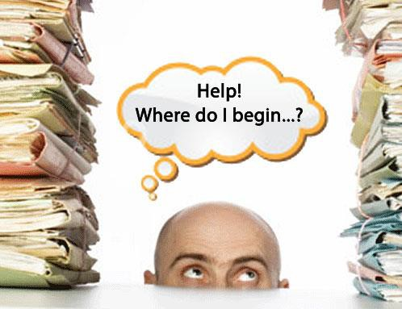
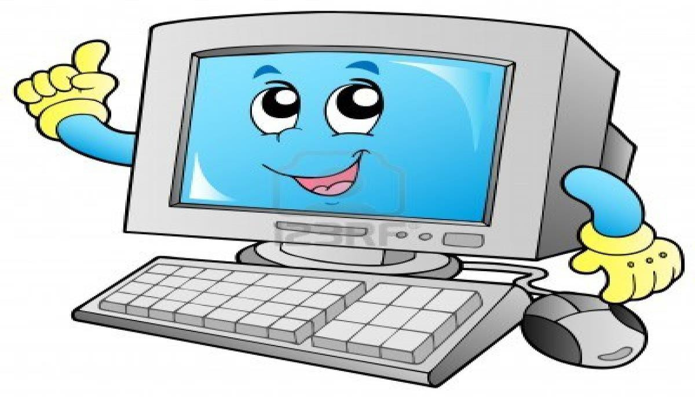
Humans are not good at analyzing massive amounts of data.
Hey but I’m good at it and can do it super fast!
Data Mining, Machine Learning, Visualization

Slide 13
How??
Describe data by discovering new patterns:
Collect probabilities
Discover association rules (A implies B)
Discover clusters (clusters of dots on a graph)
Predict/classify via Clusters:
K-nearest neighbors classifier ➔ in this cluster or that cluster
Predict/classify via Supervised Machine Learning:
Learned from Data => Now predict the output for a new instance
Neural networks found a weight vector for features ➔yes or no
Found a decision tree based on features ➔ yes or no
SVM found a decision boundary ➔ yes or no

Slide 14
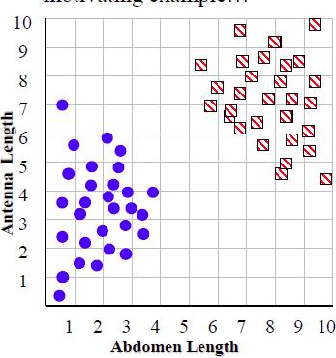
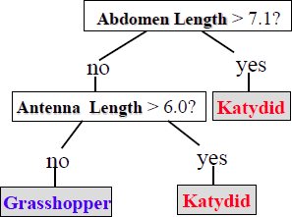
Example classification outputs

Slide 15
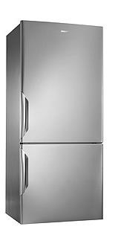
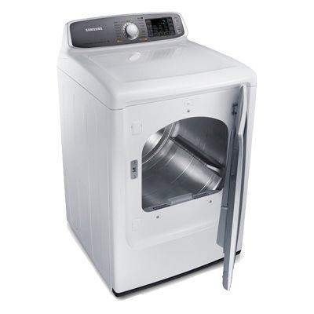
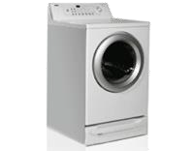
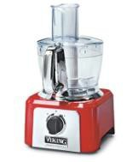
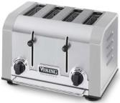
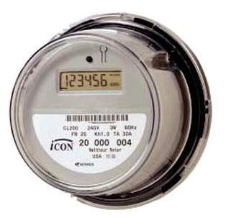
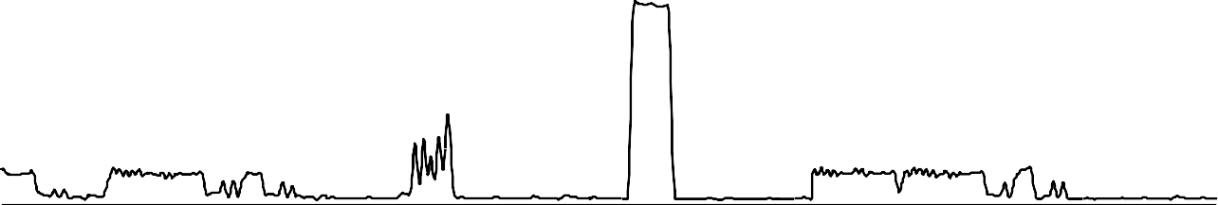
15500
16000
16500
17000
Here is an example of rule based prediction by Dr. Keogh and students @ UCR Electrical power demand produces terabytes of time series data.
Can an algorithm look in this data and find predictive rules?
15

Slide 16
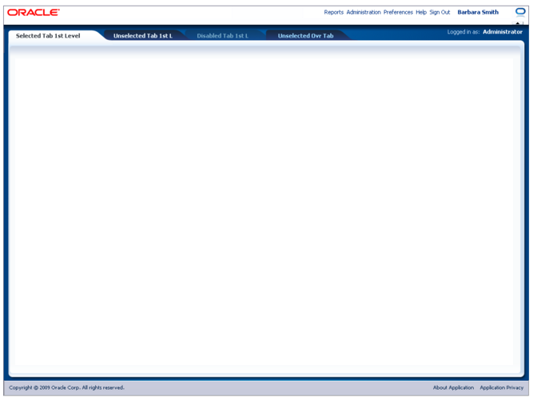
They have found
this rule
maxlag = 20 minutes
15500
16000
16500
1
7000
0
120
0
180
We did find this rule, read as: If you see this, within 20 min you will see that.
16

Slide 17
Result = Bi-Directional IoT
Any device with sensors
Analysis of Big Data
Internet
Automatically Warn, Adjust, Operate
+ M2M communication
➔Cyber Physical Systems

Slide 18
Bi-Directional IoT == Good??
Prevent crimes (e.g. Santa Cruz) through predictions
Prevent illnesses through classification
Self-driving vehicles (10 million in 2020)
Self-operating machines
Warn you when you are not eating right
Warn you when your dog is not healthy
Remotely and automatically do all construction/agricultural work
Can you think of other benefits???

Slide 19

Problems?
Need many more IT/CS people to work on this
75000 shortage in Japan in 2030
Decreasing number of domestic CS researchers in the U.S.
Security & Crimes – But use AI to prevent?
Lose jobs? (Two white house reports)
No drivers needed?
Do the things computers cannot do. (Change in Education)
Privacy and who owns the data?
New laws (e.g. self driving cars)
SigAI (ACM) Seminar on concerns about “AI and Ethics”
Rika
2017-12-07 00:02:51
--------------------------------------------
IOT devices are very vulnerabe to hacking. Mirai virus was used as "botnet" to do denial of service attacks on amazon, etc. Its source code was released by Anna Senpai. People on the dark net improved it and advertise attack for hire. Medical devices and web cams are most vulnerable. Can easily find the passwords.

Slide 20
What am I interested in???
Decades from now…..
The future is exciting

Slide 21
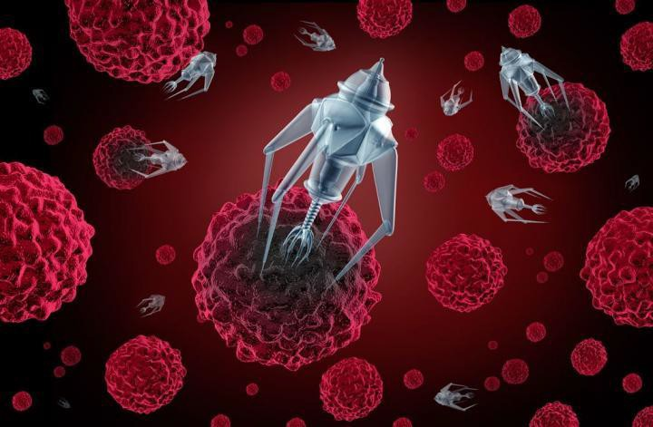
The Future of IoT + Big Data: Nanomachine/nanorobot doctors
We will find and kill all the bad things in your body.

Slide 22
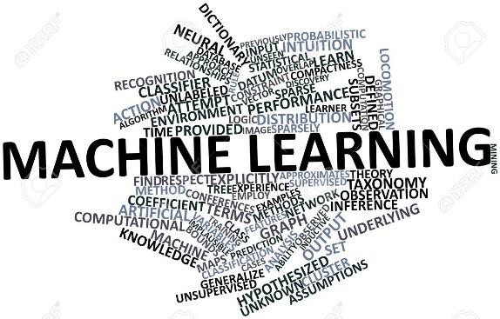

Future of AI + Big Data:
Learn Everything + Tutor Everything
Machines that learn everything by reading everything and use the knowledge to provide private tutoring on everything. [I would call this one “Intelligent”]
Requires perfect Natural Language Understanding.
Recommend YouTube videos by Tom Mitchell of CMU on NELL.

Slide 23
Example Dialog:
Mary comes home.
Mary: I don’t understand this homework problem. Help.
Robo: Ok, I see that this is an algebra problem. Have you tried factoring first?
Mary: I don’t know how to factor.
Robo: Ok, let me give you some examples to start with..
Robot gives examples.
Mary works on the problem.
Robo intervenes and gives more hints.

Slide 24
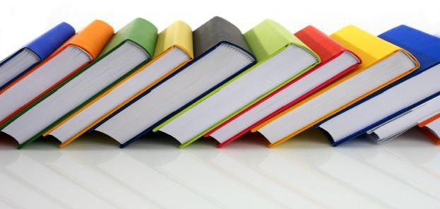
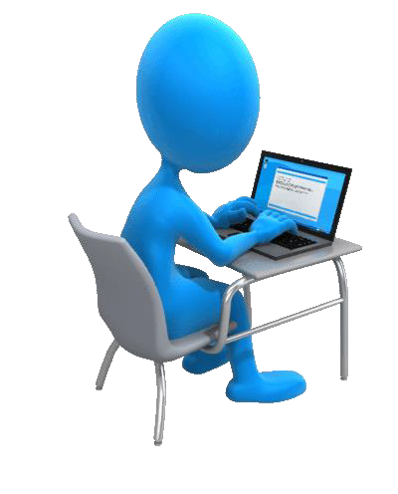
Machine
Learning
Domain
Knowledge
Pedagogical Knowledge
Dynamically creates
interactions
Student Model Constantly Updated
Interface

Slide 25
Discussion:
1.
2.
3.
Do you want a predictable world? Do you want an automated world? How do we prepare for the future??
Thank you!!

